Slide 1


GROUP SHOWCASE
CycleSignal
AI powered cycle tracking for earlier PCOS risk awareness
Group 1 · Anuja Jayakumar, Fiona Edocket, Ling Tsai · Mentor: Emma
Notes:
We are Group 1: Anuja Jayakumar, Fiona Edocket and Ling Tsai, with our mentor Emma. This is CycleSignal, AI powered cycle tracking for earlier PCOS risk awareness. It is an awareness tool, not a diagnosis.
Ling

Slide 2
PCOS is easy to miss one symptom at a time
About 1 in 10
Up to 70%
women of reproductive age have PCOS
of them do not know it
Scattered signs
Invisible between visits
No one sign settles it
Irregular cycles, weight changes, skin and hair changes. Each one is easy to dismiss on its own.
Nobody sees how a cycle behaves from month to month unless someone is tracking it.
A GP looks at the whole picture, so the app should bring that picture to the appointment.
Our idea: help someone notice the pattern and take it to a GP.
CycleSignal · group showcase · Sources: WHO (2023), via ACP Internist (2024)
1
Notes:
Why we chose it. About one in ten women has PCOS, and up to seventy percent of them are undiagnosed. Many wait years, because the early signs, like long or irregular cycles, are easy to dismiss. Wearables and cycle logs already capture those signals, but nothing turns them into a clear nudge to see a doctor. We wanted to see how far existing data could take us towards earlier awareness, and where it stops.
Ling

Slide 3
What CycleSignal tells her
01
02
03
How long was the cycle
Regular or irregular
Did ovulation happen, and roughly when
Counted from the period dates she logs.
Judged from her own cycle history, not a textbook 28 days.
Seen, not seen or not enough data, with an estimated day when the evidence is strong. Context only, not part of the score.
A wearable and a short monthly check-in become one risk-awareness score, with reasons. Worth discussing with a doctor, never a diagnosis.
CycleSignal · group showcase
2
Notes:
The short version. A person wears a Fitbit-style watch and logs her period dates and a short monthly check-in. No blood tests. The app tells her how long her cycles are, whether they are regular or irregular, and whether ovulation was seen, as context. Those become one risk-awareness score, with the reasons behind it, and a suggestion to talk to a doctor when it makes sense. It helps someone notice a pattern and take it to a GP.
Ling

Slide 4

MEET SARAH
60-second demo clip plays here
One watch, a few taps a month, and a score she can take to her GP.
Notes:
Meet Sarah. She wears a watch and logs a few things in the app. On day one the app has no history, so it gives a cautious score and says so. Three months later her cycles are long and irregular, and the app shows a higher score, the reasons behind it, and a suggestion to talk to a doctor. That is CycleSignal.
Ling

Slide 5
Two datasets, two parts of CycleSignal
mcPHASES: 42 young adults in Canada, 20 of whom completed a second 3-month interval, with daily hormone tests as ground truth.
Source | What it gives us | Used for
Fitbit Sense | Temperature, heart rate, HRV, breathing, sleep | Model 1 inputs
Mira Plus kit | Daily LH, estrogen and progesterone metabolites | Ovulation labels, training and testing only
Kaggle PCOS clinical dataset: 541 clinical records from 10 hospitals in Kerala, India, including 177 PCOS and 364 non-PCOS cases.
Source | What it gives us | Used for
Kaggle clinical data | AGE, BMI, Cycle regularity and length, Weight gain, excess hair growth, skin darkening and more. | Model 2 inputs
CycleSignal · group showcase
4
Notes:
How we worked: two datasets, one for each half of the question. mcPHASES is a research dataset of 42 young adults in Canada, with Fitbit Sense data and daily hormone tests, and 20 of them completed a second three-month interval. The hormone tests make the labels trustworthy. Glucose only exists for the first interval, so we left it out. The Kaggle clinical dataset has 541 patients from ten hospitals in Kerala, India, 177 of them with PCOS, and no wearable data. Because the two come from different people, each model is trained and tested on its own.
Fiona

Slide 6
Model 1: cycle length, regularity and ovulation
What worked
What did not work
Cycle length and regularity, from logged period dates.
Regular or irregular matched the diary for 24 of 25 people.
Median cycle of 30 days across 69 cycles.
A gap of 90+ days always says "see a doctor".
Ovulation from wrist temperature failed our pre-set checks.
Too many false alarms, and no better than a calendar guess.
Only its calibration passed.
So temperature is shown as context, never scored.
We kept the check, and reported the result.
CycleSignal · group showcase
5
Notes:
Model 1 handles the cycle. From logged period dates it works out cycle length and whether the cycles are regular, using the FIGO 2018 definition. That part worked: regular or irregular matched the participants' diaries for 24 of 25 people, with a median cycle of 30 days across 69 cycles. A gap of 90 days or more always triggers a see-a-doctor message. The part that did not work is ovulation from wrist temperature. It failed the checks we set in advance: too many false alarms, no better than a calendar-based guess, and rarely confident. Only its calibration passed. So temperature is shown as context only and never scored. We kept the check and reported the result.
Fiona

Slide 7
Model 2: PCOS-risk awareness profile
Four models compared on 541 clinical patients, using only what a user can tell the app. No labs or ultrasound.
Model | ROC-AUC | Recall | Precision
Extra Trees (chosen) | 0.92 | 0.81 | 0.78
Random Forest | 0.91 | 0.75 | 0.82
Logistic Regression | 0.89 | 0.72 | 0.87
XGBoost | 0.90 | 0.72 | 0.81
20% held-out test set. Extra Trees was chosen for the highest recall, since we prioritised recall while maintaining reasonable precision and F1. .
 | Pred non-PCOS | Pred PCOS
Actual non-PCOS | 65 | 8
Actual PCOS | 7 | 29
Strongest SHAP drivers: skin darkening, excess hair growth and weight gain.
Threshold 0.5, Lowering to 0.4 increased recall only slightly
(80.6% → 83.3%) while increasing false positives (8 → 12).
CycleSignal · group showcase
6
Notes:
Model 2 is the PCOS-risk part. We trained it on 541 clinical patients, using only inputs a person can self-report, like cycle regularity, weight gain, hair growth, skin darkening and acne. We compared four models with cross-validation and a twenty percent held-out test set. Extra Trees did best, with a ROC-AUC of 0.92, recall of 0.81 and precision of 0.78. We chose it for recall, because missing a case is worse than a false alarm, so it catches about eight in ten cases but still misses some. SHAP showed skin darkening, excess hair growth and weight gain as the strongest drivers. It never sees wearable data.
Anuja

Slide 8

How the two models become one score
Model 1 — Cycle Pattern
Model 2 — PCOS Profile
Example: Sarah
40%
of score
60%
of score
Cycle component (40%)
= 30.0 points
• Based on logged cycle history
• Extra Trees output
Model 2 component (60%)
• Regularity / persistent long or short cycles
• Uses 11 self-reportable inputs
= 58.0 points
• Infrequent periods / 90+ day gap
• Symptoms, BMI, period regularity and period length
CycleSignal
score
88.0 / 100
Temperature / ovulation
Context only, excluded from the score and escalation
Score bands
Low · Some patterns to monitor · Increased · Elevated
Agent recommendation
Uses separate safety/escalation rules, not the score alone (e.g. ‘worth discussing with a doctor soon’).
Prototype only. The 40/60 weights and score bands are project heuristics, not clinically validated. The combined score is not a probability of PCOS or a diagnosis.
CycleSignal · group showcase
7
Notes:
So Model 2 gives us the PCOS-associated profile score, and SHAP tells us what is driving that score for the individual. The next step was combining that with the longitudinal cycle pattern from Model 1 to create the prototype CycleSignal risk-awareness score.
Sarah is the illustrative example requested for this presentation: cycle component 30.0 points plus Model 2 component 58.0 points equals 88.0 / 100. These supplied example values do not establish a freshly computed output of the current 11-input pipeline.
Source-of-truth review: 26 October 2026. Main commit 3b77e8a6c1fa5225d4a6f11dd33ac14835350206.
https://github.com/eoc3001/WAI---GROUP1/blob/3b77e8a6c1fa5225d4a6f11dd33ac14835350206/combined_score/cyclesignal_risk_score.py
https://github.com/eoc3001/WAI---GROUP1/blob/3b77e8a6c1fa5225d4a6f11dd33ac14835350206/app/cyclesignal_core.py
https://github.com/eoc3001/WAI---GROUP1/blob/3b77e8a6c1fa5225d4a6f11dd33ac14835350206/agent/levels.py
Live site reviewed: https://f-ayanae.github.io/WAI---GROUP1/
Period length in Model 2 means days bleeding, not completed cycle intervals. The blended score includes overlapping cycle information. No clinical validation is claimed.
Anuja presents Model 2 and SHAP before this slide. Keep this section focused on the prototype combination: 40% cycle pattern and 60% PCOS profile. Model 2 period length means days bleeding. Temperature and ovulation are context only because the wearable ovulation model did not pass validation. The agent applies separate safety/escalation rules rather than the score alone.
Anuja

Slide 9
Issues we hit, and how we resolved them
Issue | What happened | Resolution
Two datasets, no link | No dataset has both wearable data and a PCOS diagnosis. | Each model is tested on its own. The combined score is not validated on anyone.
Ovulation check failed | Temperature failed our pre-set checks. | Shown as context only and kept out of the score.
Counting evidence twice | Cycle answers could count twice in the score. | Recalculated the Model 2 flag with cycle inputs neutralised before combining evidence.
Odd training-data effects | Some answers, like acne, lowered the score for some users. | Those bars are faded and labelled as data quirks, not advice.
Gaps in testing | 9 participants were FIGO-irregular, but none met stricter escalation rule. Model 2 comes from just one hospital network in India. | Marked that escalation rule as unvalidated. Model 2 generalisability is limited.
Demo data | No real patient was wearing a watch, and the score weights are our own choices. | Demo nights are simulated, and we say so on screen.
We kept every claim to what the data can support.
CycleSignal · group showcase
8
Notes:
Issues and how we handled them. First, no dataset has both wearable data and a PCOS diagnosis, so each model is tested alone and the combined score is unvalidated. Second, our temperature-based ovulation check failed the criteria we set in advance, so it is context only. Third, cycle evidence could be counted twice, so the androgen check runs with cycle answers set to regular. Fourth, the training data had odd effects, like acne lowering the score for some users, so those bars are faded and labelled. Fifth, no participant met the irregular-cycle criteria, and Model 2 comes from one hospital network in India, so it may not generalise. Last, the demo nights are simulated and the weights are our own choices. We say all of this on screen.
Anuja

Slide 10
Key learnings
01
Decide what not to claim
Most of our design effort went into what the app should not say, not into the model.
02
A failed check is a result
Ovulation from temperature did not pass. Reporting that made the product more honest.
03
Pick the metric for the risk
We chose recall over precision, because a missed case costs more than a false alarm.
04
Explain every score
Showing which answers moved the score makes it easier to trust and to question.
05
Label data quirks
If the training data looks odd, say so on screen instead of hiding it.
06
Do not count evidence twice
Keep unvalidated signals as context, and keep each signal in one place.
CycleSignal · group showcase
9
Notes:
Key learnings. First, most of our design effort went into deciding what the app should not claim. Second, a failed check is still a result, and ovulation from temperature not passing made the design more honest. Third, pick the metric that fits the risk: we chose recall over precision because a missed case costs more than a false alarm. Fourth, explain every score so users can question it. Fifth, label odd data effects instead of hiding them. And last, do not count the same evidence twice, and keep unvalidated signals as context.
Ling

Slide 11
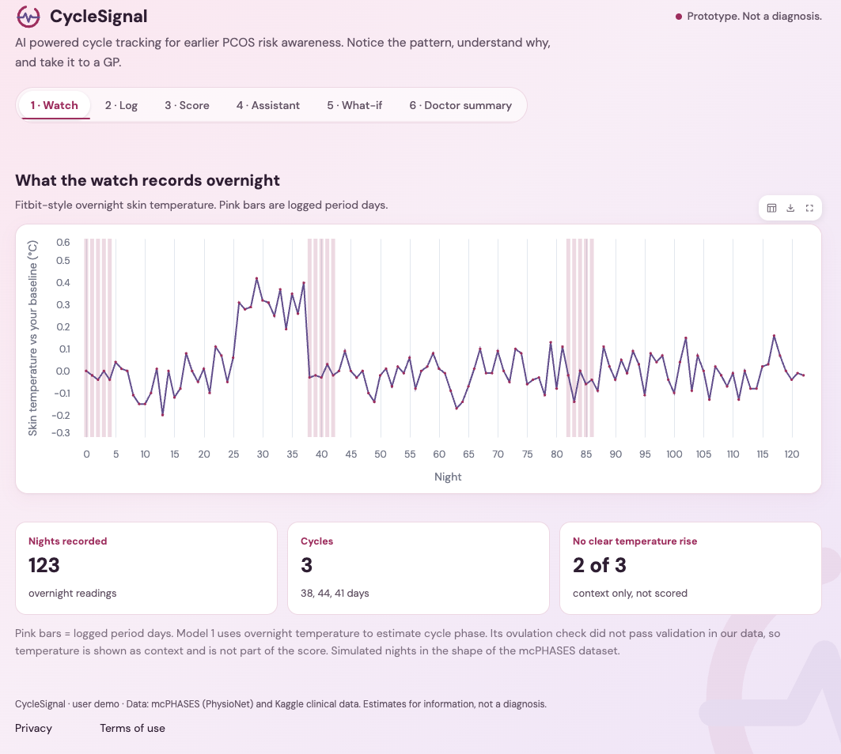
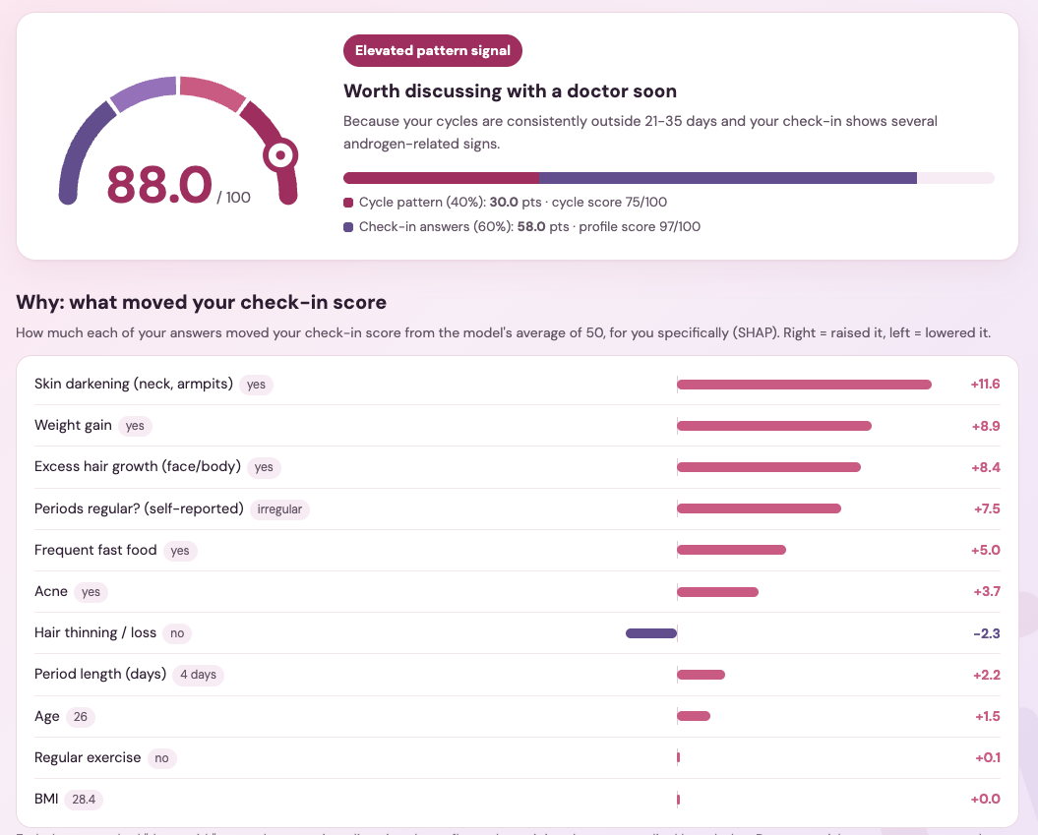
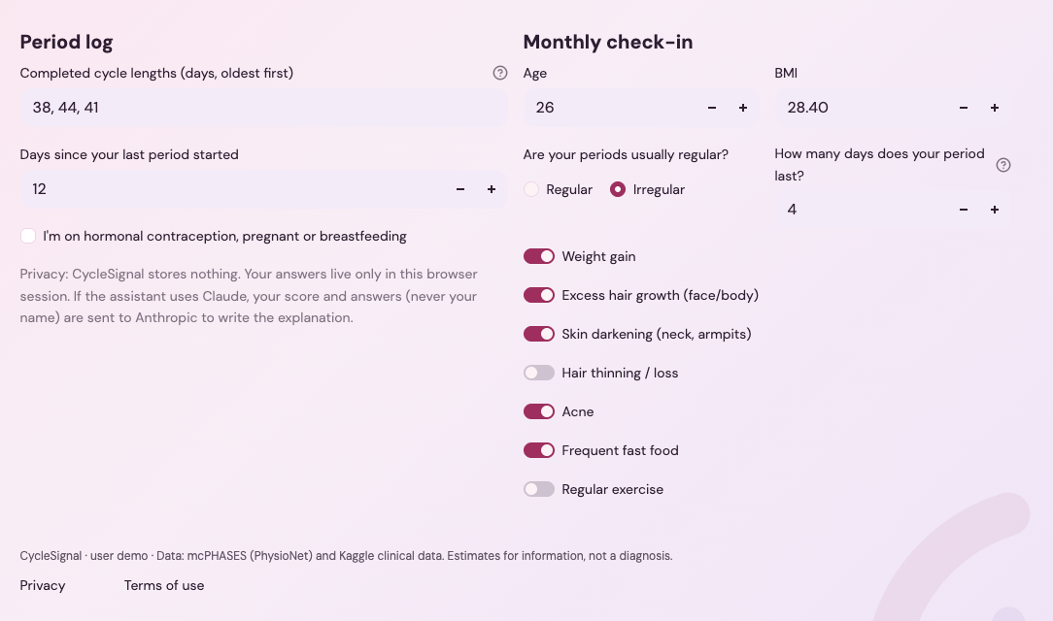
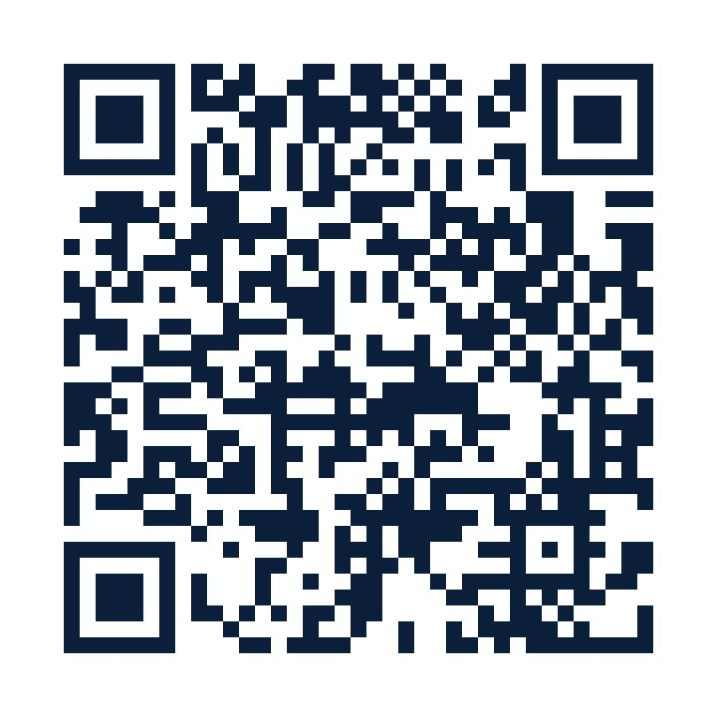
CycleSignal Web App
Scan to access the blog + web app
CycleSignal · group showcase
10
Notes:
Ling

Slide 12
Next Steps
1
2
3
4
5
Same-person data
A diverse cohort
A validated ovulation detector
A clinical study
Medical-device approval
A group that reflects the women who would use it.
To test the combined score against real diagnoses.
Watch, symptoms and a confirmed diagnosis, followed for 6 to 12 months.
Needed before any clinical use.
Checked against hormone tests.
CycleSignal: earlier awareness, not a diagnosis?
CycleSignal · group showcase
11
Notes:
Final results and next steps. Model 2 reaches 0.92 ROC-AUC on held-out patients. The score and the app work end to end in a prototype. The combined flag and the ovulation detector are not yet proven. To build the real thing, we need data from the same people, a diverse group, an ovulation detector that passes validation against hormone tests, a clinical study, and medical device approval. CycleSignal: earlier awareness, not a diagnosis. Thank you, we are happy to take questions
Fiona

Slide 13
Questions?
CycleSignal: earlier awareness, not a diagnosis.
Group 1: Anuja Jayakumar, Fiona Edocket, Ling Tsai · Mentor: Emma
CycleSignal · group showcase
12
Notes:
Thanks for watching. Questions are welcome in the three minute Q and A.
Fiona

Slide 14
Final results: what works today
Model 2 works
The prototype app works
Model 1: half works
ROC-AUC 0.92, recall 0.81 and precision 0.78 on held-out patients. It catches about 8 in 10 cases and still misses some.
Cycle pattern and check-in answers become one score with reasons, a what-if view and a doctor summary. Sarah scores 66.0 on day 1 and 88.0 after 3 months. Aoife scores 19.7.
Cycle length and regularity matched the diary for 24 of 25 people. Ovulation from temperature did not pass, so it is context only.
A working prototype, not yet validated end to end.
CycleSignal · group showcase
11
Notes:
Final results. Model 2 works: a ROC-AUC of 0.92, recall of 0.81 and precision of 0.78 on held-out patients. The prototype app works end to end: cycle pattern and check-in answers become one score with reasons, a what-if view and a doctor summary. For Model 1, cycle length and regularity matched the diary for 24 of 25 people, but ovulation from temperature did not pass, so it is context only. It is a working prototype, not yet validated end to end.

Slide 15
What the user sees
SCORE
WHY
88.0
What is driving it
One score, the reasons behind it, and a summary to take to her GP.
Skin darkening +12
Weight gain +9
Hair growth +8
Irregular periods +7.5
Elevated pattern signal
An assistant that explains the result in plain words
A what-if view of which answers move the score
A one-page summary to download
40% from her cycle pattern, 60% from her check-in answers.
Worth discussing with a doctor.
Cycles: 38, 44 and 41 days (typical: 21 to 35)
Points added to her check-in score. Temperature is context only.
Fictional demo user Sarah. Real output from our code.
Estimate for information, not a diagnosis.
CycleSignal · group showcase
11
Notes:
Here is the same product in detail. The score card shows 88 as an elevated pattern signal. Under it, a why card shows which answers moved the score: skin darkening, weight gain, hair growth and irregular periods. She can try a what-if, and the score drops from 88 to about 75 if some answers change. Last, a summary she can take to her GP. The wording is always risk-awareness score, worth discussing with a doctor.

Slide 16
Demo: CycleSignal today
Sarah is a fictional user. The scores are real outputs from our code. The watch nights are simulated.
Sarah, day 1
Sarah, 3 months later
Aoife, for contrast
66.0
88.0
19.7
Increased pattern signal
Elevated pattern signal
Low pattern signal
No cycle history yet, so the app uses a cautious placeholder and shows a low-confidence banner.
Cycles of 38, 44 and 41 days, all longer than the typical 21 to 35. No temperature rise picked up in 2 of 3 cycles.
Regular cycles and few symptoms. A low score still cannot rule PCOS out.
A risk-awareness score, worth discussing with a doctor. Never a diagnosis.
CycleSignal · group showcase
8
Notes:
Now the demo. Sarah is a fictional user. On day one she has no history, so the score is a cautious 66, with a low-confidence banner. Three months later she has logged cycles of 38, 44 and 41 days, all longer than the typical 21 to 35, and the score is 88, an elevated pattern signal. For contrast, Aoife has regular cycles and few symptoms, and scores 19.7. The scores are real outputs from our code. The watch nights are simulated.

Slide 17
What this does not prove yet
No dataset links wearable data to a PCOS diagnosis.
mcPHASES
Kaggle clinical data
So
Records no PCOS diagnoses, and has 42 people.
Has no wearable signals.
Each model is tested on its own. The combined flag is untested and needs a future study.
Outputs are estimates for information. They are not for contraception or diagnosis.
CycleSignal · user demo
14
Notes:
Say this plainly and early in Q and A if it comes up. We have two datasets that each answer half of the question. Model 1 learns what ovulation looks like in wearable data. Model 2 learns a risk profile from clinical records. Nobody has data that connects the two, so the combined flag has not been tested. That is the next study, and being upfront about it is a strength.

Slide 18
Putting the data together
1. Build the daily table
2. Nightly signals, on her own scale
3. Check data quality
Join the files on participant id and day in study. A night counts on the day she wakes.
Needs 10+ nights and an early-cycle reference, otherwise: not enough wearable data.
Temperature, sleeping heart rate, HRV and breathing, centred on her early-cycle level.
4. Label cycles from hormones
5. Split by person
6. Keep extras out for now
From subject-info: each participant, and both of her study rounds, stay on one side.
Glucose (round 1 only), calories, steps and similar files stay out. Stress and exercise may come back later.
A PdG rise confirms ovulation in each cycle. Used only to train and test, never as an input.
CycleSignal · user demo
6
Notes:
This is the part that is easy to get lost in, so keep it to the logic. We join everything on participant id and day in study. Each person's signals are measured against her own early-cycle level, because absolute temperature varies a lot between people. Hormone values only create the answer key. And we split by person so the model is always tested on someone it has never seen.

Slide 19
Model 1 results on held-out people
Measure | Model 1 | Step-fit | Current rule
Sensitivity at false alarm 20% or less | [__] | [__] | [__]
NPV | [__] | [__] | [__]
AUC (95% CI by person) | [__] | [__] | [__]
Ovulation-day error (days) | [__] | [__] | [__]
Calibration (ECE) | [__] | [__] | [__]
Cycles with enough data | [__] | [__] | [__]
Status: in the app, the ovulation check did not pass validation in our data, so temperature is shown as context only and is not part of the score. Fill in the held-out numbers and say so plainly. Model 2 results are on slide 10.
CycleSignal · user demo
9
Notes:
Placeholder slide. The live app already says Model 1's ovulation check did not pass validation, so do not present these as a success. Fill each bracket from the held-out test run and delete the instruction line at the bottom. If one result is weak, show it anyway and say what it means. If the model does not beat the baselines, that is a finding, not a failure to hide. Add a chart of one participant's temperature with the model's ovulation call next to the hormone-confirmed day if there is time.

Slide 20
How we test Model 1
Leave one person out
Detection metrics
Each person is scored by a model that has never seen her. Calibration uses a 5-fold split grouped by person.
Sensitivity at a false-alarm rate of 20% or less, NPV and AUC, with 95% confidence intervals by person.
Trust and timing
A bar to clear
Calibration (ECE), so a stated confidence means what it says, and the error in the estimated ovulation day.
It must beat the step-fit baseline and the current rule on paired AUC. Regular and irregular cycles are reported separately.
CycleSignal · user demo
8
Notes:
The key idea is that nobody gets scored by a model that has seen their data. We also set the bar in advance: the model has to beat two simpler approaches, otherwise it is not worth using. Reporting regular and irregular cycles separately matters because irregular cycles are exactly the hard, important case.

Slide 21
Tomorrow: one woman, end to end
Concept · illustrative data
With data from the same women, followed for 6 to 12 months, ending in a confirmed diagnosis.
Timeline
Rotterdam tracker
Nine months become one story. A validated ovulation detector shows when ovulation stops, and the score becomes a calibrated likelihood with an uncertainty band.
Tracks the three areas doctors use. Two of three show evidence, so it recommends a GP visit and prepares a referral summary.
Labs and scan
Clinician view
With her consent, she adds results from a photo of her GP letter, for a more confident reading.
Her doctor sees the full picture. With consent, the diagnosis goes back to the model as a label, so it keeps learning.
CycleSignal · user demo
15
Notes:
Video B plays here: the 45-second promo, or the full walkthrough. Everything on this slide is a concept with illustrative data, and the banner says so. Today our cycle data and our symptom data come from different people in different countries. The key step is data from the same women, followed for six to twelve months, with a confirmed diagnosis at the end. Then the four views: the timeline, the Rotterdam tracker, labs and scan, and the clinician view where the diagnosis feeds back as a label.

Slide 22

A normal day for the wearer
Wears a Fitbit Sense
Logs in the app
Gets one score
Period dates with one tap, then a monthly check-in on weight, periods, hair, skin, diet and exercise. No blood tests.
A risk-awareness score with the reasons behind it, and a summary she can take to her GP.
Overnight temperature, sleeping heart rate, HRV, breathing and sleep are collected without her doing anything.
In the study data, a hormone kit and daily diary gave us the ground truth. They were used only to train and test the model, never as inputs.
CycleSignal · user demo
4
Notes:
Walk through it as a story. The watch works in the background, she logs a few things, and she gets one score with the reasons behind it. The hormone kit appears only in the research data: it tells the model what really happened so we can check its answers, but a real user would not need one.

